Slide 1
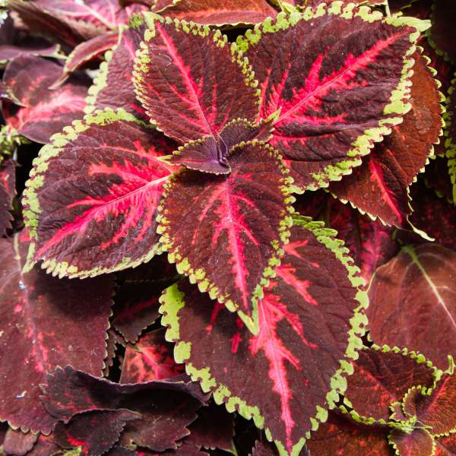
Coleus
Assorted Sun Series
Sold in 4” pots
Price: $4/pot
Other colors available
Coleus is a great plant for both sunny and shady locations, growing well as borders or in containers. With their unique colored and patterned foliage, the Sun Series will brighten any part of your yard or patio. The three Sun Series varieties sold are selected to work together to create spectacular color but may be purchased separately. These varieties tolerate full sun, but color is often more intense in partial shade.
Light: Full Sun to Partial Shade
Water: Container – Once Daily
Yard – 2-3 times weekly
Temperature: Tender, Overwinter Indoors

